Slide 1

Leading Technical People

Slide 2
Chapter Overview
Two contrasting views (Theories X and Y)
Approaches to Motivation
Content Theories (based on human needs)
Process Theories (behavior is determined by expected outcomes)
Nature of Leadership
Effectively motivating Technical Professionals

Slide 3
Leadership
.
Leadership is the process of getting the cooperation of others in accomplishing a desired goal.
A mixture of persuasion, compulsion and example that makes men do what you want them to do.
It is the ability of men to get men to do what they don’t want to do and like it.

Slide 4
Nature of Leadership
Leadership is formal (titular) or emergent (informal)
They have the authority
(power of reward and
punishment)
They are true leaders
Formal leaders: committee chair, branch manager, team captain Have the advantage of formal authority of reward and punish, they can easily persuade others
Informal leaders: through referent power or expertise

Slide 5
Formal Leader | Informal Leader
Envoy the formal authority over the subordinates | No formal authority over the subordinates
Help to achieve organizational goals | Help to satisfy individual goals along with formal goals
Formally appointed by mangers | Emerge out from interaction of informal goals
Employees comply to their order | Employ are committed to their orders
Do very little to increase moral & job satisfaction of subordinates | Increase moral and job satisfaction of subordinates

Slide 6
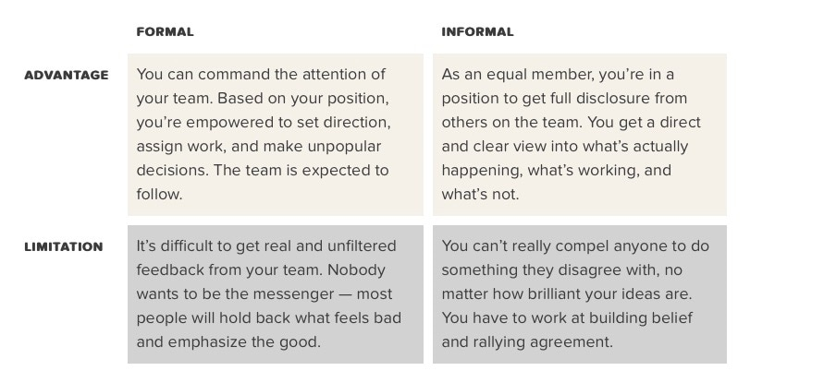

Slide 7
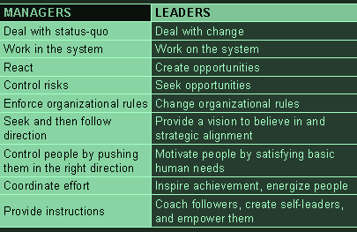
Notes:
Status-quo existing state of affairs

Slide 8
Leadership Traits (Personal Characteristics)
Physical qualities of health, vitality and endurance
Personnel attributes of personal magnetism, cooperativeness, ability to inspire, persuasiveness, forcefulness and tact
Character attributes of integrity, humanism, self- discipline, stability, and industry
Intellectual qualities of mental capacity, ability to teach others and a scientific approach to problems

Slide 9
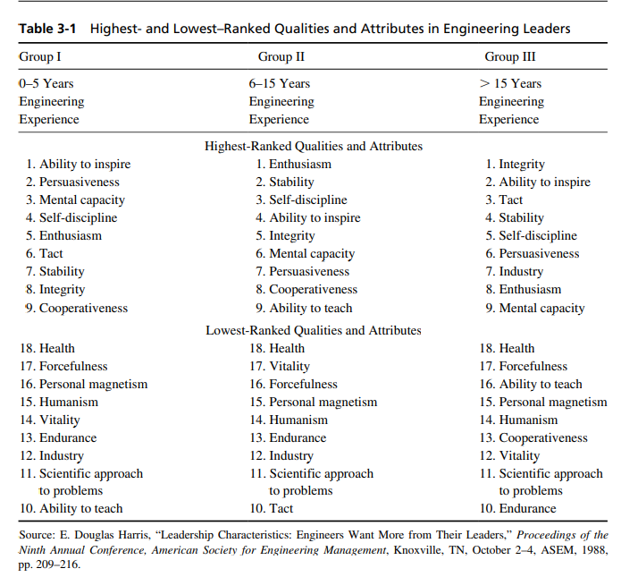

Slide 10
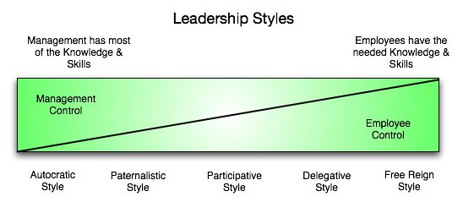

Slide 11
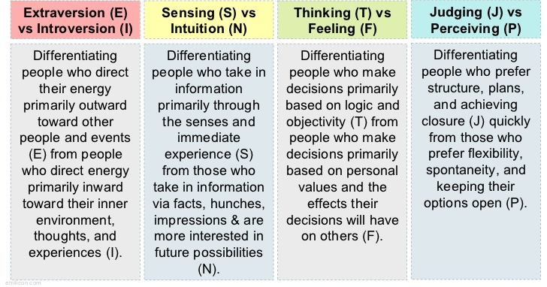
Myers-Briggs Preferences Myers-Briggs Type Indicator (MBTI) measures personal preferences on four scales, each made up of two opposite preferences:

Slide 12
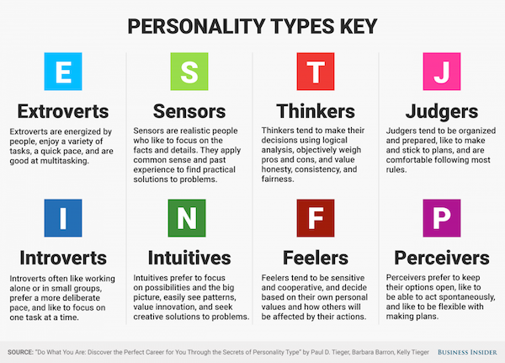

Slide 13
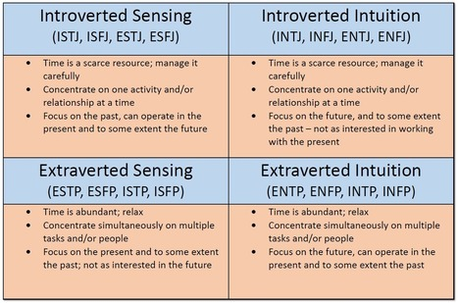

Slide 14

ENTJ
(Extroversion-Intuition-Thinking-Judging)
Engineering managers
INTJ
(Introversion-Intuition-Thinking-Judging)
Scientists, Researchers
ISFP
(Introversion-Sensing-Feeling-Perceiving)
Worst case,
non-experienced
professional

Slide 15
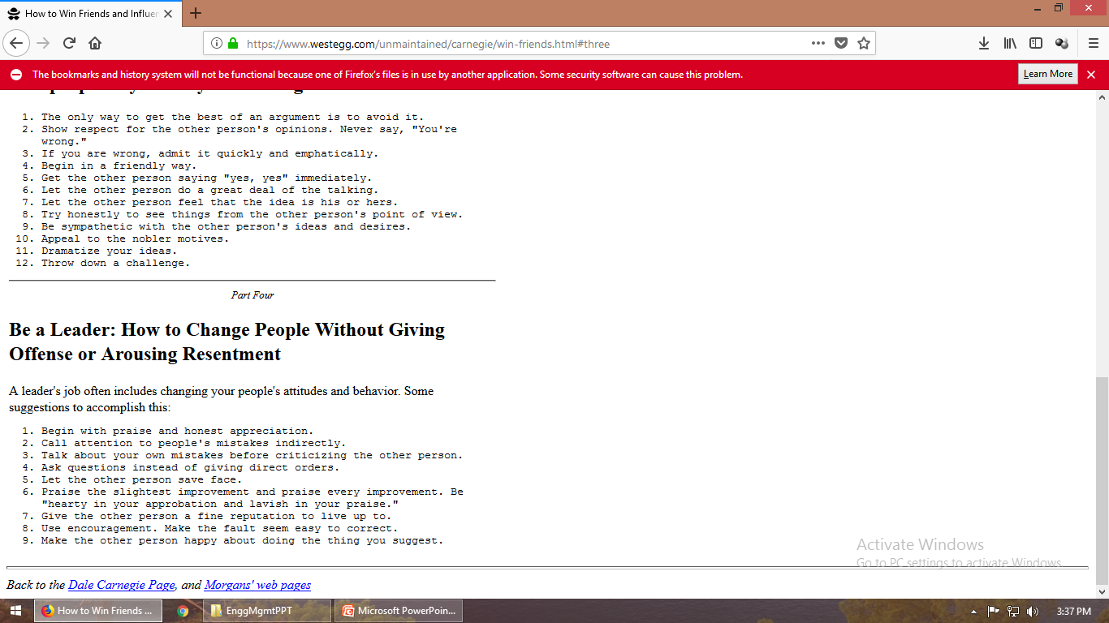
https://www.westegg.com/unmaintained/carnegie/win-friends.html

Slide 16
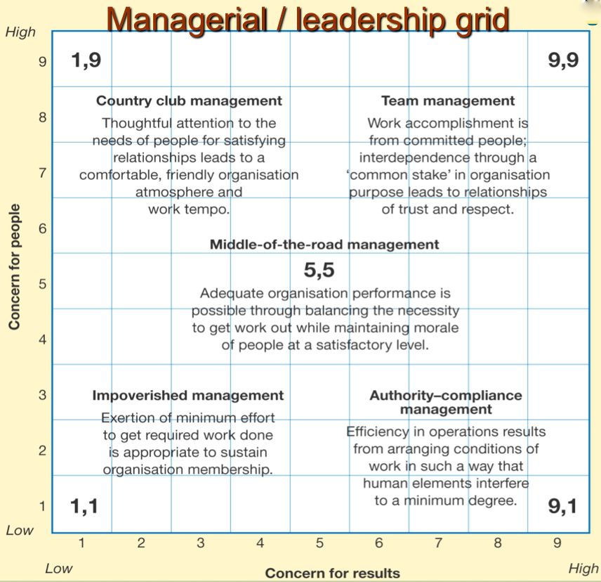
People/Task Matrix Approaches
The Leadership Grid

Slide 17
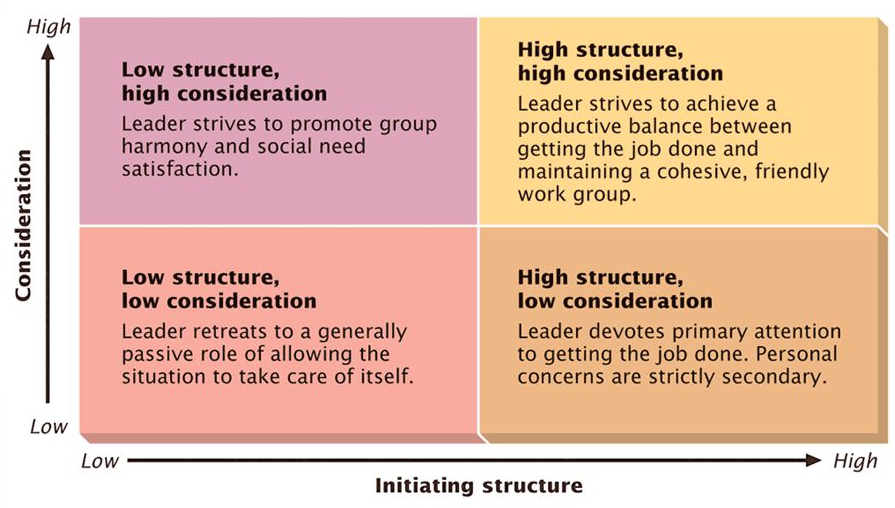
Ohio State Leadership Styles
Initiating structure refers to the task actions of the leader to define who does what and how, while consideration is a measure of the leader’s concerns for followers.

Slide 18
Initiating
Structure (IS)
Consideration (C)
Low
High
High
H(IS)/L(C)
H(IS)/H(C)
Low
L(IS)/L(C)
L(IS)/H(C)
Findings:
High IS – High C may not be the most effective
High IS helps only if task is unstructured.
High C helps only if there is no adequate alt. source of satisfaction

Slide 19
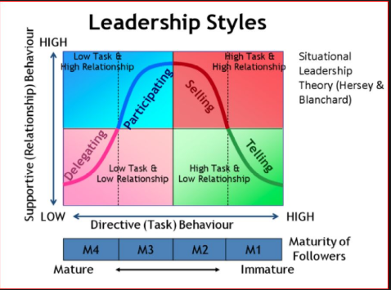
Hersey and Blanchard Leadership Model

Slide 20
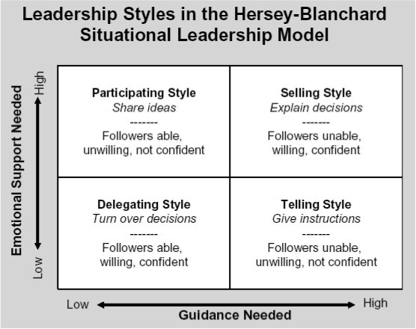

Slide 21
Situational Approaches Contingency Theory
The manager must develop a reward system, a leadership style, or an organizational structure to be appropriate for the unique combination of such factors as
the nature of the subordinates,
the technology of the business and the tasks that result,
the rate of change in the organization,
the degree of integration of functions required,
the amount of time the manager has to accomplish the assignment,
the quality of the manager's relationship with subordinates.

Slide 22
Leadership Continuum
"a continuum of leadership style extending from complete retention of power by the manager to complete freedom for subordinates"
Autocratic ("Telling"). Manager makes decisions with little or no involvement of non-managers.
Diplomatic ("Selling). Manager makes decisions without consultation but tries to persuade non-managers to accept them.
Consultative ("Consulting"). Manager obtains non-managers' ideas and uses them in decision making.
Participative ("Joining"). Manager involves non-managers heavily in the decision (and may even delegate it to them completely).

Slide 23
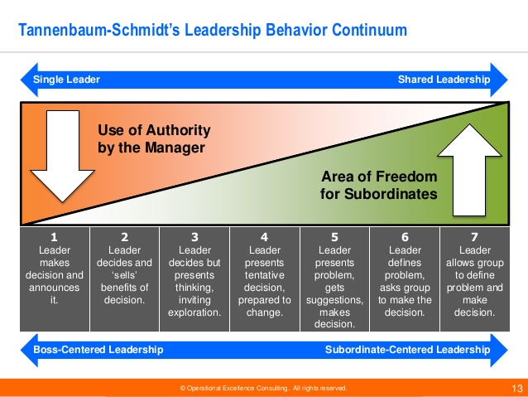

Slide 24
Three forces to consider before deciding on management style as proposed by Tannenbaum and Schmidt:
Forces in the manager – value system, own leadership inclinations, confidence in nonmanagers, feelings of security in uncertain situations
Forces in the subordinate (or nonmanager) – greater delegation when nonmanagers need independence, are ready to assume responsibility, can tolerate ambiguity, are interested in problem
Forces in the situation – type of organization and the amount of delegation, experience of nonmanagers working as a group, nature and complexity of problem, pressure of time

Slide 25
Contingency Theory and Situational Theory
Both theories focus on the individuality of a leader being relationship oriented or task oriented.
Situational leadership is related to contingency theory in that both state that the effectiveness of a leader depends on matching the leader's abilities and approach to the situation
Contingency theory stresses matching the leader (with his or her existing characteristics) to the current situation whereas situational leadership emphasizes the leader's need to adapt to his or her followers.

Slide 26
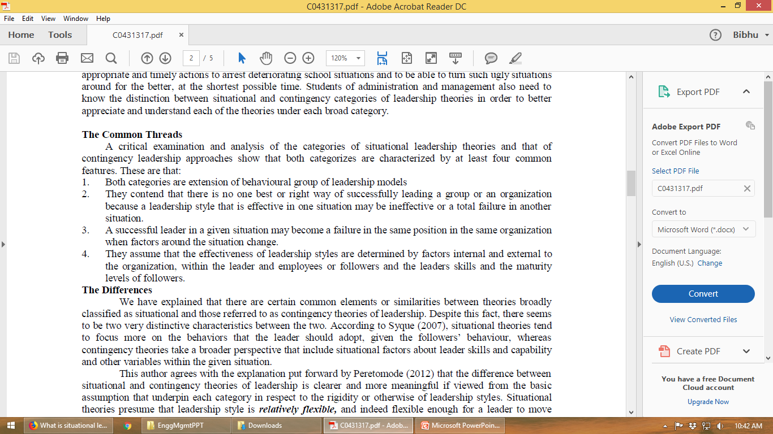
Similarities
Differences
Situational theories tend to focus more on the behaviors that the leader should adopt, given the followers’ behavior, whereas contingency theories take a broader perspective that include situational factors about leader skills and capability and other variables within the given situation.
Situational theories – relatively flexible; contingency theories – relatively inflexible.
Unlike contingency approach, to situational theories, effectiveness of leaders depends on successfully diagnosing where subordinates are on the development continuum and adapting their leadership style as necessary.

Slide 27
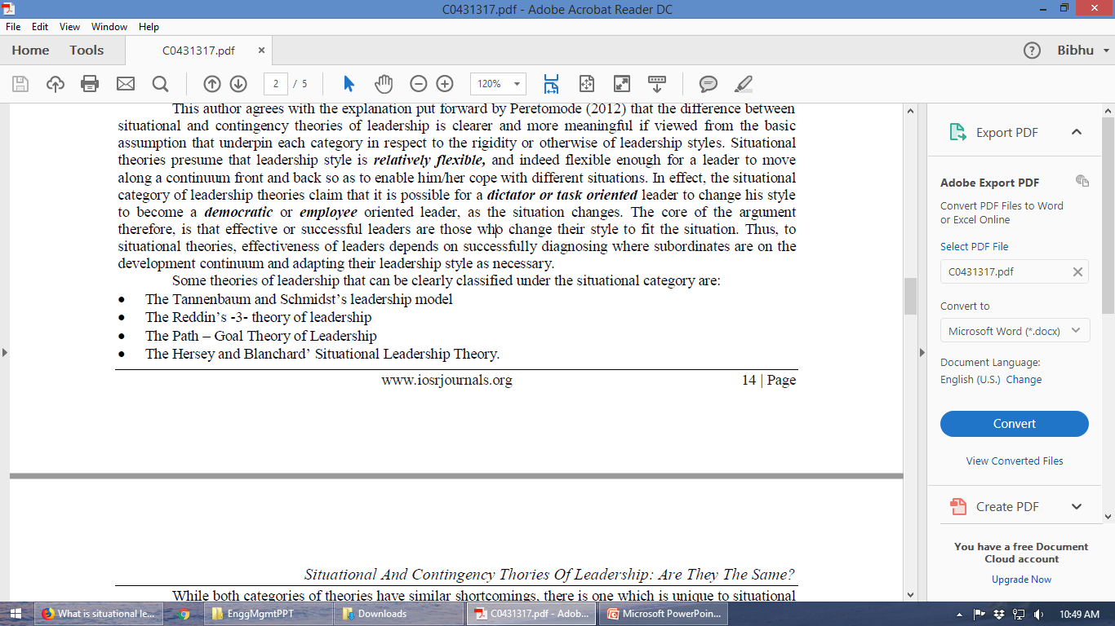
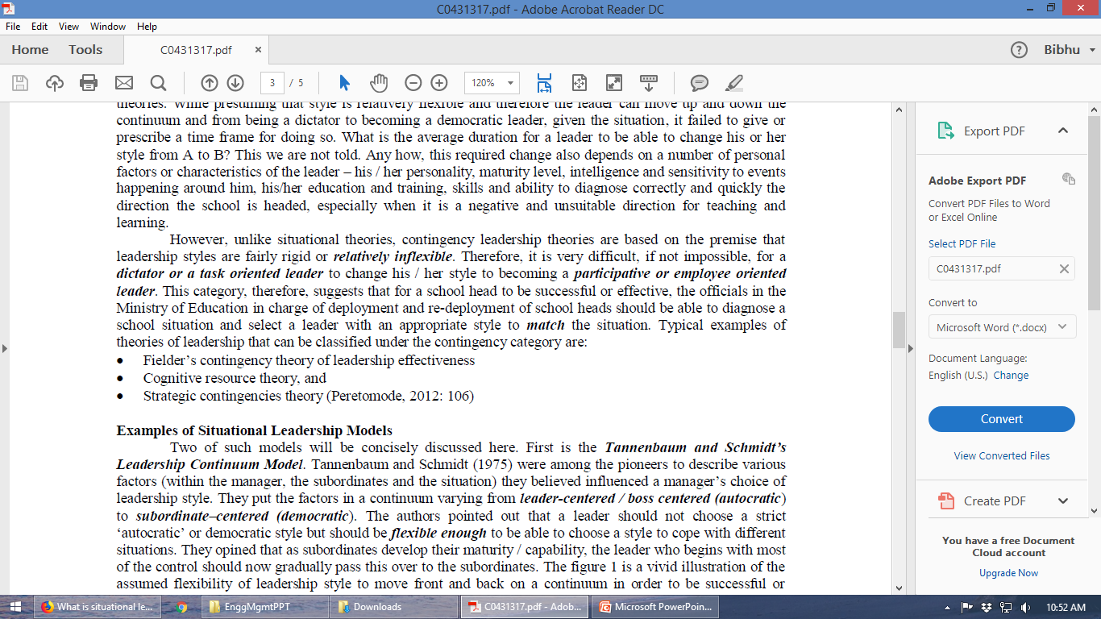
Situational theories of leadership
Contingency theories of leadership

Slide 28
Contingency Theory | Situational Theory
consists of a leaders natural ability to adapt based on their leadership style. | flexible to the leader, giving the opportunity to use the appropriate skills to resolve or attend to a situation.
predicts that all followers will function simultaneously based on the style of the leader. | believes that the followers will have altered responses based on their personal level of combined efforts of being willing, able, and confident.

Slide 29
(Example#1): In the event that there was a black out during your shift at work, there would be no room for situational leadership being that everyone would be responding the same, displaying feelings of panic. This issue would seek the direct leadership style that is administered from the Contingency theory.
(Example#2): Put yourself in the shoes of a soldier at war, who looks for accurate instructions based on the “in the moment” situations that present themselves. To be able to efficiently adjust on impulse shows a soldiers’ willingness to comply and remain confident within uniform at all times.

Slide 30
What is Servant Leadership?
Servant leadership is a term used to describe the managerial style of those who want to do good for the sake of doing good (for instance, helping their loved ones or a community), and realize they can use their abilities to help lead and manage others.
The basis of a servant leader’s leadership skills relies on them providing solutions to their customers first and foremost.
By focusing on the needs of others, they establish authority and likeability because they create positive change in the lives of those around them.
Example: Southwest Airlines

Slide 31
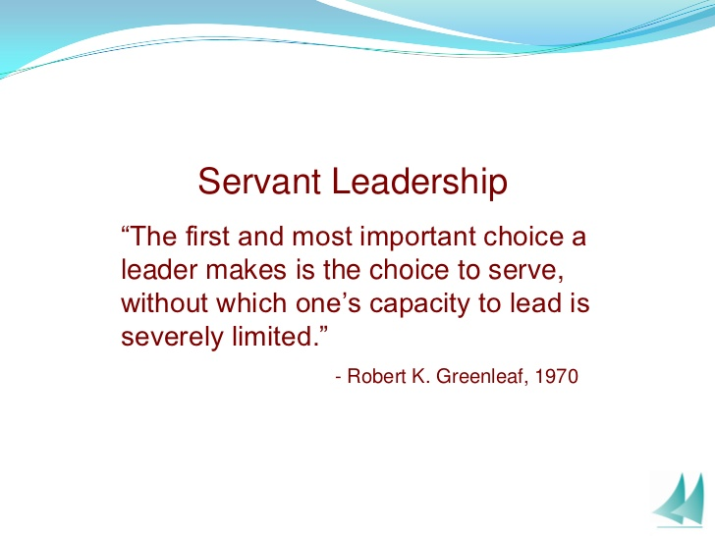
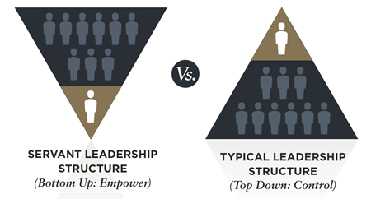

Slide 32
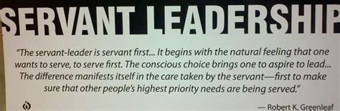
Servant Leadership

Slide 33
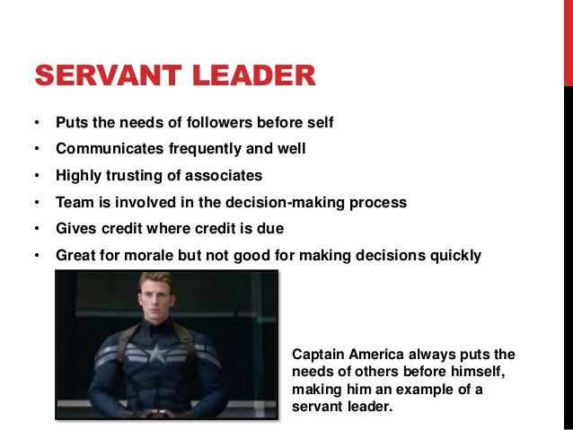

Slide 34
"A leader is best
when people barely know that he exists,
not so good when people obey and acclaim him,
worst when they despise him.
"Fail to honor people, they fail to honor you":
But of a good leader, who talks little,
when his work is done, his aim fulfilled,
they will all say, "We did this ourselves.“
Lao Tsu, Philosopher, China.

Slide 35
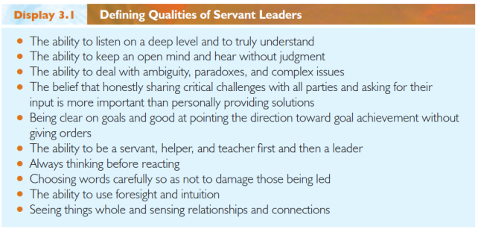

Slide 36
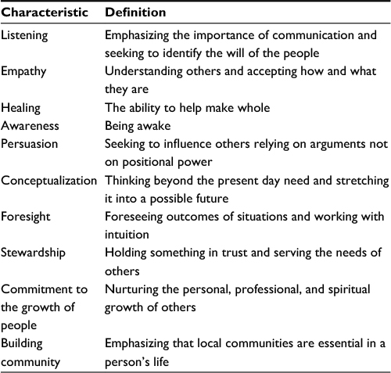
Characteristics of Servant Leadership

Slide 37
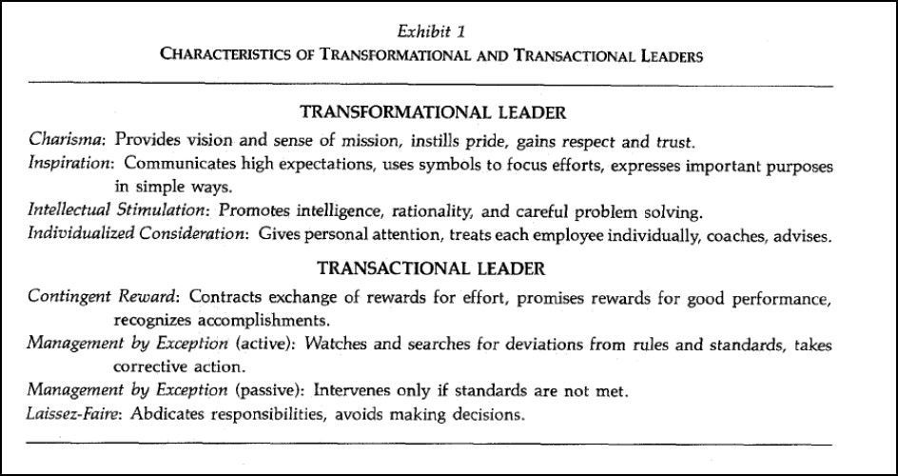

Slide 38
Motivation
Motive - An inner state that energizes, activates, or moves and that directs or channels behavior toward goals.
Company Goals
Motivation is the feeling that directs
the person toward goals

Slide 39
Motivation
We can define motivation in terms of three measures
1. Direction
Direction
(When several alternatives are available)

Slide 40
Motivation
We can define motivation in terms of three measures
2. Strength of behavior when choice is made
Direction
Strength
Bigger heart shows larger motivation

Slide 41
Motivation
We can define motivation in terms of three measures
3. Persistence of Behavior
Strength
Persistence shows the consistency and continuousness

Slide 42
Motivation
There is only one way if you want the people to make something for you
Making them want to do it.
In other words, motivate them.

Slide 43
McGregor’s Theory X & Theory Y
Theory X
Management is responsible for organizing the elements of productive enterprise (money, materials, equipment, people)
We have to motivate people, direct their efforts, control their actions and modify their behavior to fit the needs of organization
If we don’t do this people would be passive even resistant to organization needs. They must be persuaded, rewarded, punished, and controlled by management.

Slide 44
McGregor’s Theory X
People always have to be motivated by management: Carrot & Stick Approach
Manager

Slide 45
McGregor’s Theory X
Behind this conventional theory there are several beliefs to support
The average person is by nature indolent
He lacks ambition, dislikes responsibility, prefers to be led.
He is self-centered, indifferent to organizational needs.
He is by nature resistant to change.
He is gullible, not very bright, the ready dupe of charlatan and demagogue

Slide 46
McGregor’s Theory Y
Theory Y is opposite to that of Theory X as following,
Management is responsible for organizing the elements of productive enterprise (money, materials, equipment, people)
People are not passive by nature. They have become so as a result of experience in organizations.
The motivation, potential, and the readiness to direct behavior toward organization goal are all present in people.
Main task of management is to arrange organizational conditions and methods of operation so that people can achieve their own goals.

Slide 47
McGregor’s Theory X & Theory Y
Theory X relies upon external control of human behavior.
Treats people as child
Not valid for knowledge workers such as engineers
Not valid even for manual workers of developed societies
Theory Y relies upon self-control and self direction.
Knowledge has to be self-directed.

Slide 48
THEORIES of MOTIVATION
CONTENT THEORIES
PROCESS THEORIES
Based on human needs and
and satisfaction of them
Behavioral choices are made
more rationally based on expected
outcomes

Slide 49
Content Theories:
Based on human needs and people’s effort to satisfy them
Maslow's hierarchy of needs
Herzberg's 2-factor theory
McClelland’s Trio of Needs
Process Theories:
Assumes that behavioral choices are based on expected outcomes
Equity Theory (Adams)
Expectancy Theory (Vroom)
Porter-Lawler Extension
Behavior Modification (Skinner)

Slide 50
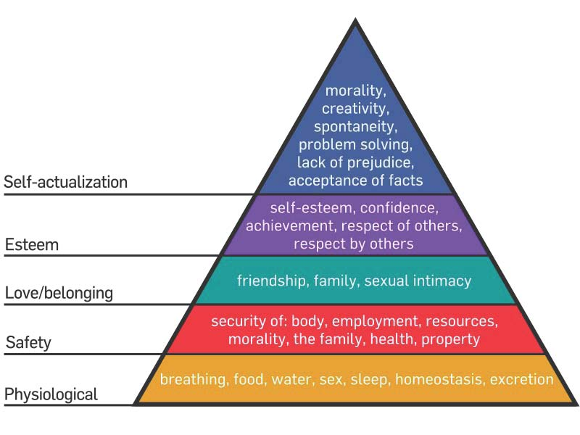
Maslow’s Hierarchy of Needs
Human Needs arrange themselves in hierarchies of prepotency. Appearance of one need usually rests on the prior satisfaction of another

Slide 51
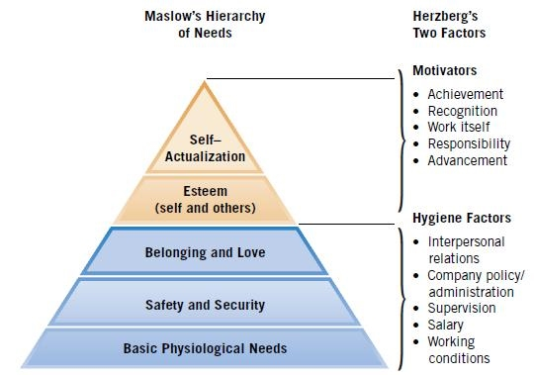
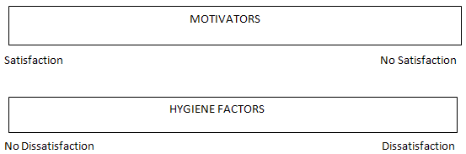
Herzberg’s Two Factor Theory

Slide 53
Herzberg’s Two-Factor Theory
Hygiene Factors Motivation Factors
Salary Recognition
Working Conditions Work itself
Company Policies Responsibility
Relationship with Boss Advancement
Relationship with peer Achievement

Slide 54
Content Theories: McClelland’s Trio of Needs
Need for
achievement
Need for
power
Need for
affiliation

Slide 55
McClelland’s Trio of Needs
Mixture of three needs
Need for Achievement
Need for Power
Need for Affiliation

Slide 56
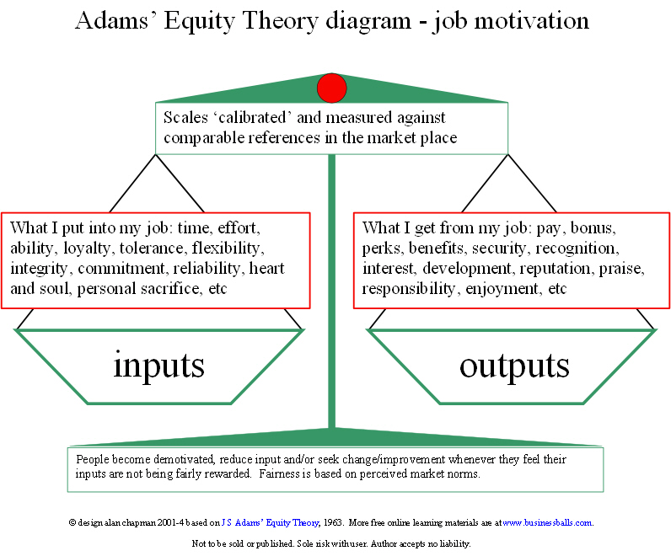
Process Theories: Equity Theory

Slide 57
Equity theory of motivation looks at an individual’s perceived fairness of an employment situation and finds that perceived inequalities can lead to changes in behaviour.
When individuals believe that they have been treated unfairly in comparison with their co-workers, they will react in one of four ways:
Changing their work inputs to better match the rewards they are receiving.
Ask for a raise or take legal action.
Change their own perception of the situation.
Quit.

Slide 58
Process Theories: Expectancy Theory
Relates the effort a person puts forward to the expectation of achieving some desired goal.
1
2
Effort-to-Performance
Expectancy
Performance-to-outcome
Expectancy

Slide 59
Process Theories contd....
Expectancy Theory
It relates the” effort a person puts forth “to “the expectation of achieving some desired goals”
Two expectancies:
Effort -to -performance expectancy
Its a person’s perception of the probability that one’s effort will lead to high performance
It is also a function of ability of a person , environment
Effort –to- outcome expectancy
Its a person’s perception that attaining the performance described above will lead to intrinsic & extrinsic rewards

Slide 60
Expectancy Theory
Expectancy Theory: Relates the effort a person puts forward to the expectation of achieving some desired goal.
Environment
Effort
Performance
Outcomes
Ability
Effort-to-Performance
Expectancy
Performance-to-outcome
Expectancy

Slide 61
Process Theories: Porter- Lawler Extension to Expectancy Theory
Porter-Lawler Extension to Expectancy Theory: It adds satisfaction to
the Expectancy Theory.
Satisfaction
Effort
Performance
Outcomes
* Personal effort, abilities, role perceptions, environment determine performance
* Performance, in turn, leads to intrinsic and extrinsic rewards as in expectancy
* The perceived equity determines the satisfaction
* Satisfaction influences future effort

Slide 62
Porter- Lawler Extension to Expectancy Theory
Porter-Lawler Extension to Expectancy Theory: It adds satisfaction to
the Expectancy Theory.
Satisfaction
Effort
Performance
Outcomes
Expectancy Theory + Satisfaction + Feedback for future effort

Slide 63
Process Theories: Reinforcement Theory
Behavior Modification (Reinforcement Theory): Motivation (behavior)
followed by an event (reinforcement) which affects the repetition of behavior.
Satisfaction
Effort
Performance
Outcomes
Event
Reinforcement

Slide 64
Reinforcement Theory
Behavior Modification (Reinforcement Theory): Motivation (behavior)
followed by an event (reinforcement) which affects the repetition of behavior.
Satisfaction
Reinforcement
Event

Slide 65
Reinforcement Theory
Behavior Modification (Reinforcement Theory): Motivation (behavior)
followed by an event (reinforcement) which affects the repetition of behavior.
Reinforcement
Positive Reinforcement: Increases the repetition of desired behavior by
providing a reward (promotion, recognition etc)
Negative Reinforcement or Avoidance: Increases the repetition of desired
behavior by letting the employee escape from undesired consequences
Punishment: Decreases the repetition of undesired behavior by
imposing penalties
Extinction: Decreases the repetition of undesired behavior by
simply ignoring and using positive reinforcement

Slide 66
Reinforcement Theory
Behavior Modification (Reinforcement Theory): Motivation (behavior)
followed by an event (reinforcement) which affects the repetition of behavior.
Reinforcement
Positive
Reinforcement
+
Punishment
Reinforcement
-
Negative
Reinforcement
Extinction

Slide 67
Process Theories contd...
Behaviour modification (Reinforcement theory)
Behaviour followed by an event that affects the probability that the behaviour is repeated
Four types of reinforcements are available to the manager:
Positive reinforcement
Desired behaviour can be repeated by providing reward
Negative reinforcement
Letting the employee escape from the undesired consequences
Punishment
Decrease the probability of repetition of undesired behaviour by imposing penalty/fine
It leads to poorer performance so use as last resort
Extinction
Decrease the probability of repetition of undesired behaviour by ignoring it and withholding positive reinforcement

Slide 68
Motivating and Leading Technical Professionals
General Nature of the Technical Professional
Having a high need for achievement and deriving their motivation primarily from the work itself.
Desiring autonomy (independence) over the conditions, pace, and content of their work.
Tending to identify first with their profession and secondarily with their company.
Seeking to maintain their expertise, gained through long and arduous study, and stave off obsolescence through continuing education.

Slide 69
Motivating Factors for Engineers
Type of work, interesting, diversified (45.0%)
Salary (33.9%)
Location, good place to live, family (31.2%)
Opportunity for advancement (29.8%)
Challenge, more responsibility, chance to use creative ability (16.9%)
Reputation, prestige of company (13.7%)
Working conditions, personnel policies (11.7%)
Growing organization, growing field (6.9%)
Security, retirement plan, benefits (6.8%)
Opportunity to learn, broaden experience, training programs (6.6%)

Slide 70
Dimensions of technical leadership
Coach for peak performance – “listen, act, facilitate, integrate, provide administrative support”
Run organizational interference - obtain resources, support professionals and minimize the bureaucracy
Orchestrate professional development
Expand individual productivity through teamwork
Facilitate self-management

Slide 71
Leading as Orchestration
Four general areas where the leader can make a difference:
Technical competence - related to scientific productivity and willingness to comply with management directives
Controlled freedom - decision making is shared but not given away, autonomy partially preserved
Leader as metronome - widen/narrow limits, add/subtract weights, speed up/slow down actions
Work challenge - manager measured by extent to which he/she can provide challenging assignments

Slide 72
Breakpoint Leadership
When influencing other parts of the organization is as important, or more important, than influencing a subordinate group, leadership is at a breakpoint
Effectiveness is not simply measurable by group productivity, but as a function of organizational direction and impact.

Slide 73
Use of Motivational Theories by Engineers
Most familiar with MBO, quality, and Peters/Waterman
Also Maslow’s hierarchy, theory X and Y, Herzberg’s two factor theory, managerial grid, leadership continuum

